Slide 1
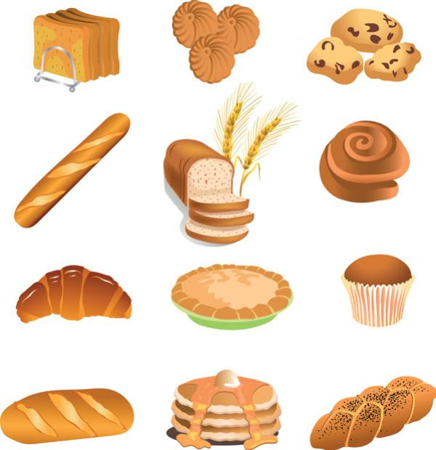
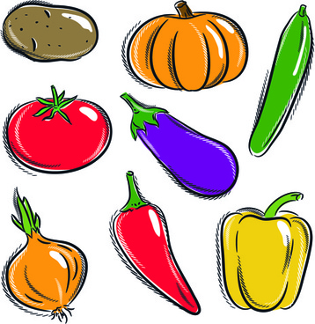
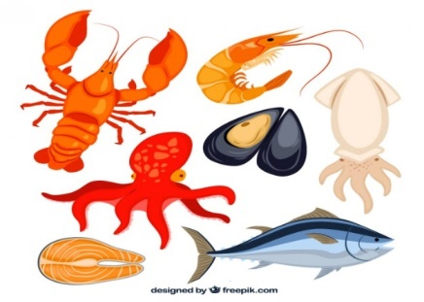
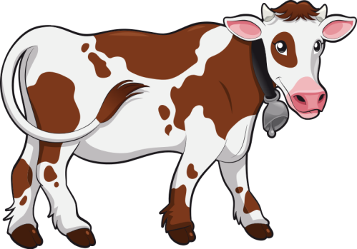
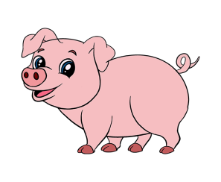
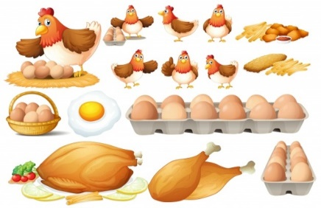
Food Arrangement Diagram
This diagram is intended to demonstrate the proper arrangement for storing food, to minimize the risk of cross-contamination; lower risk foods at the top and higher risk foods on the bottom. Foods may sit adjacent to one another on shelving with minimal risk.
Ready To Eat:
precooked items, bread,
produce, and other foods with very low risk of
cross-contaminating other items.
It SWIMS:
Fish and other seafood products
It WALKS:
Beef, pork, lamb
It FLIES:
Chicken, turkey and other poultry
products

Slide 2
Test Your Knowledge
T or F. Chicken, poultry and eggs carry the risk of salmonella.
T or F. The most common allergens are wheat, dairy, soy, eggs, seafood, and nuts.
T of F. Stacking higher risk foods, such as ground beef, on top of produce is an industry best practice.
T or F. Product should be stacked, packed and stored in such a way as to minimize risk, except for bulk pallets.
Refrigerated foods should be held at ____F or below.
Frozen foods should be held at ____F or below.
The most common foodbourne illness found in factories and warehouses is ________________________________________
The best way to avoid foodbourne illness is by ________________________________________
What order should product be packed, stacked, or stored?
T or F. It is everyone’s responsibility to keep food safe.

